Slide 1
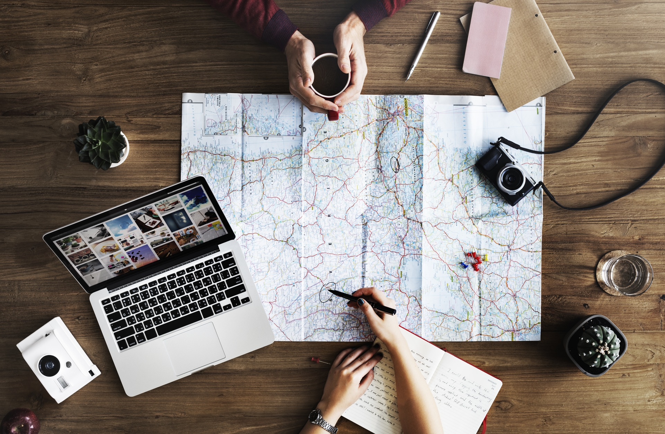
An Academic Perspective on Mobility – Capital, Power, and Belonging
Sean Casey

Slide 2
Our Agenda
My Street Cred
What is anthropology and where do digital nomads fit in?
Overview of my research
Overview of Digital Nomads and Location Independence
Mobility: capital, power, and belonging
Potential of Digital Nomads to Change… Everything

Slide 3
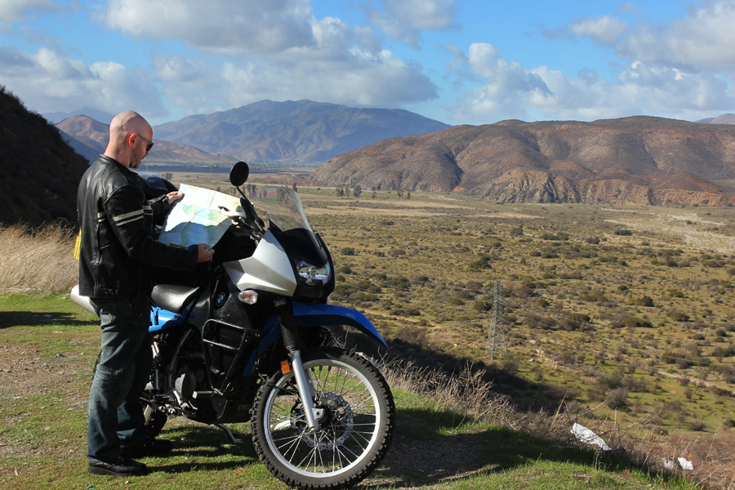
Street Cred: Digital Nomad
Travel + work abroad since 2004
5 years Japan as English teacher + underpaid ski resort bum
2007-08 – round the world photo-journalism project
2010 – started working in web; Drupal + Django
2012 – 2014 – first full-time digital nomad adventure: motorcycle trip from USA -> Tierra del Fuego
few months, few weeks, few days in lots of places in between

Slide 4
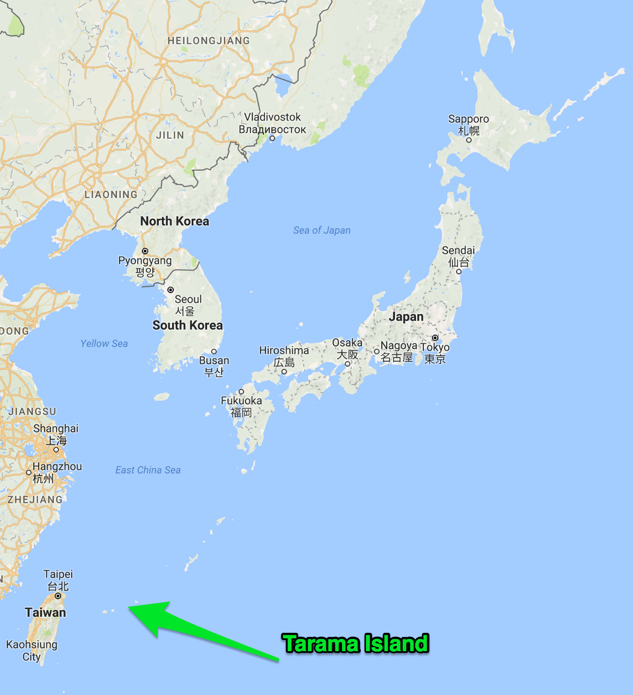
Street Cred: Academics
Anthropology M.A., University of Hawaii
- Thesis on Okinawan Heritage
Anthropology PhD (currently), University of Melbourne
- Topic: YOU GUYS!

Slide 5
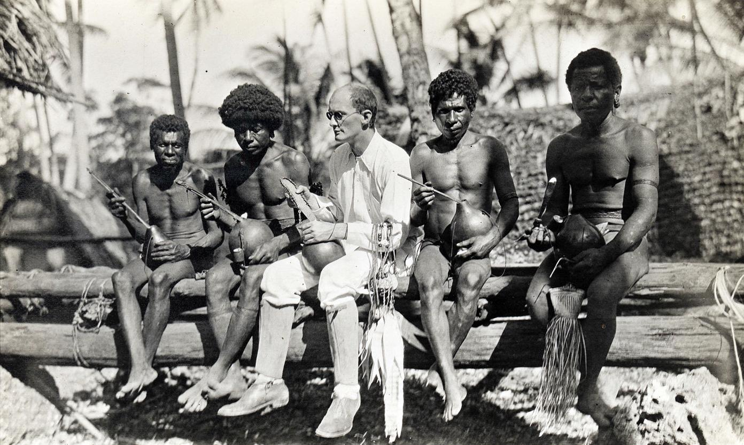
But isn’t this anthropology?

Slide 6
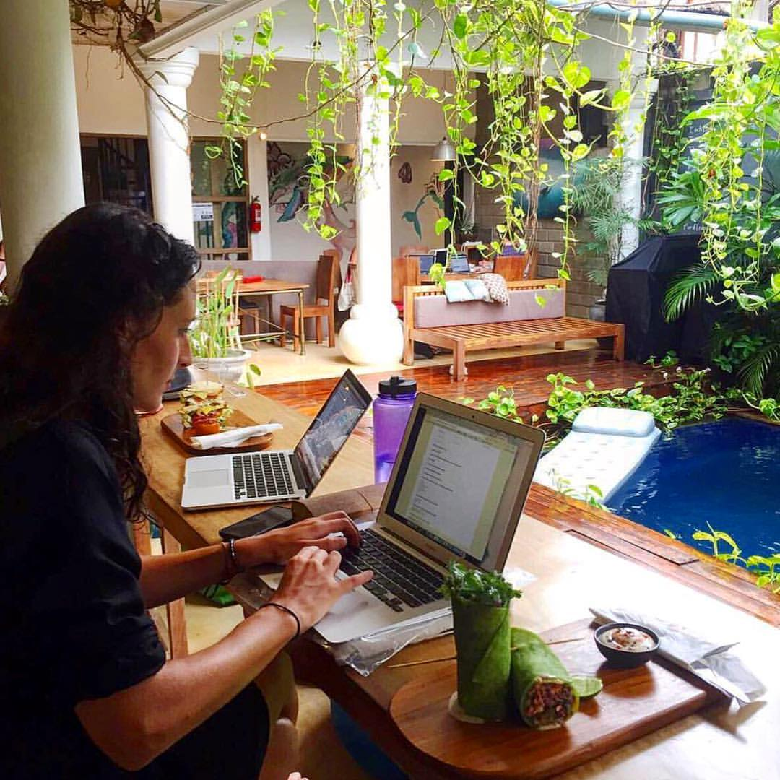
So how do digital nomads fit in?

Slide 7
My Research
Central Research Question:
How does “location independence” affect identity and relationships?
Duration:
1 year collecting data
1 year analyzing and writing dissertation

Slide 8
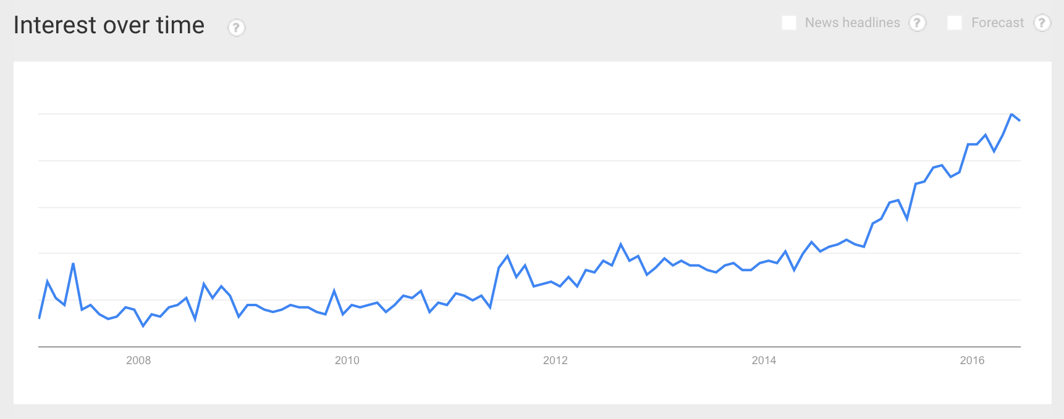
“Digital Nomad” popularity
Screenshot from Google Trends

Slide 9

Digital Nomad
1997 book
Computer Scientist
Focus on likely technological advances of the next 10 years
Short term prediction: people will be remote working while traveling soon
Long term prediction: interest-based tribes of digital nomads will replace nation states

Slide 10
Digital Nomad
“The 21st century will be the millennium which resurrects for humans a dilemma which has been dormant for 10,000 years – humans will be able to ask themselves: ‘Am I a Nomad or a Settler?’”
- from Digital Nomad

Slide 11

Location Independence
2007
D.E.A.L. - Definition, Elimination, Automation, and Liberation
Two broad concepts that appear everywhere for digital nomads:
1. 80/20 principle for maximizing time (+ profits for biz)
2. Location Independence

Slide 12
Location Independence
“L for Liberation is the mobile manifesto for the globally inclined… Liberation is not about cheap travel; it is about forever breaking the bonds that confine you to a single location”
- from The 4-Hour Workweek

Slide 13
Location Independence
Freedom/Success != money
Freedom/Success == time + mobility
This central belief is what unites digital nomads as a community
“because of its ideological roots, ‘digital nomad’ has simultaneously become a category for classifying individuals with particular habits and values, and a trope signifying a utopian mastery of one’s spatiotemporal circumstance” - me
Translation: “Digital nomad” isn’t just a term for categorizing a lifestyle, it is also a metaphor for being in complete control of time and space (i.e., location).

Slide 14
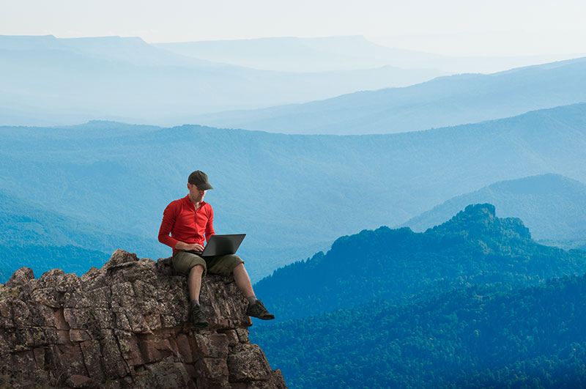
Digital Nomad: master of time and space

Slide 15

Digital Nomad: master of time and space

Slide 16
What is mobility?
mobility = potential mobility (“motility”) + movement
Aspects of mobility
- capital
- power
- belonging (identity)

Slide 17

Mobility as Capital: Is it capital?
Capital is not just money
- anything that can store value and be exchanged
- e.g., economic, human, social, cultural
Is mobility capital?
- Is it in limited supply or unevenly distributed?
- Can its value be stored?
- Can it be exchanged for other types of capital?

Slide 18
Mobility as Capital: Spending and Accumulation
accumulation practices
- remote job
- getting rid of lease
- putting possessions in storage
- credit card churning / airline miles
spending practices
- travel
- flying business class with miles
- for-profit travel blogging
- NOMAD CRUISE!

Slide 19
Mobility as Capital: “Location Independence” vs. “Digital Nomad”
Location Independence == Accumulating potential mobility?
Digital Nomad == Spending potential mobility?

Slide 20

Mobility as Power
Potential mobility is not evenly distributed
Depends on relative immobility of others
Associated with success and sophistication

Slide 21
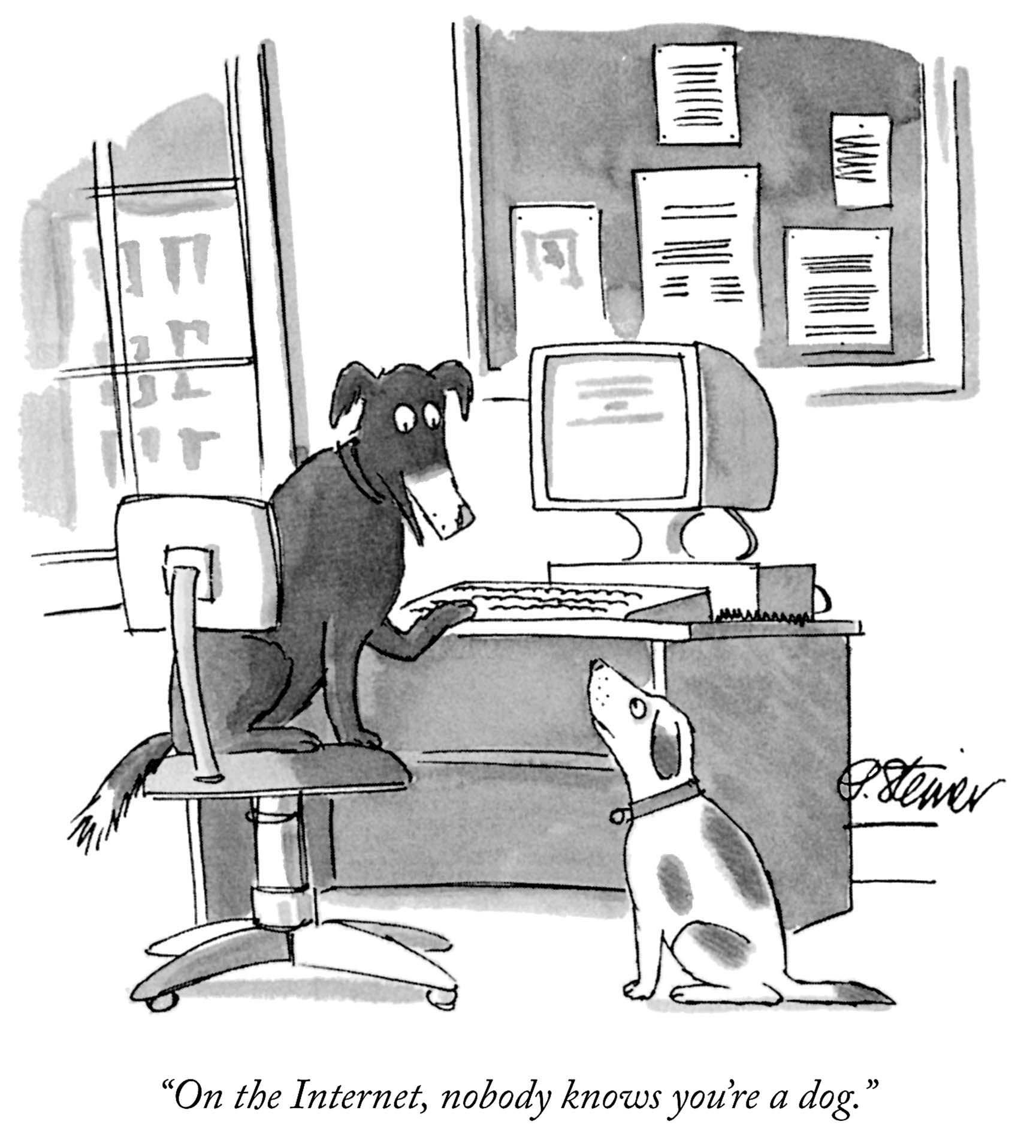
Mobility as belonging
“movo ergo sum” – becoming through movement
Travel, especially, is supposed to be transformative
Digital nomads very focused on growth and transformation
Shape our identities by sharing stories of growth on the road
- process of “witnessing and testifying”

Slide 22

Mobility on the
How are we spending/accumulating mobility capital?
How is our voyage enabled by mobility power dynamics?
How are we using mobility to belong to a tribe?

Slide 23
Concluding Thoughts

Slide 24


